Slide 1
Project Management
Syed Mahbubur Rahman

Slide 3
What is Project?
A temporary endeavor undertaken to create a unique product or service
(PMI, 2001)
A set of activities with an aim to acheive a certain goal within stipulated time frame consuming specific resources

Slide 4
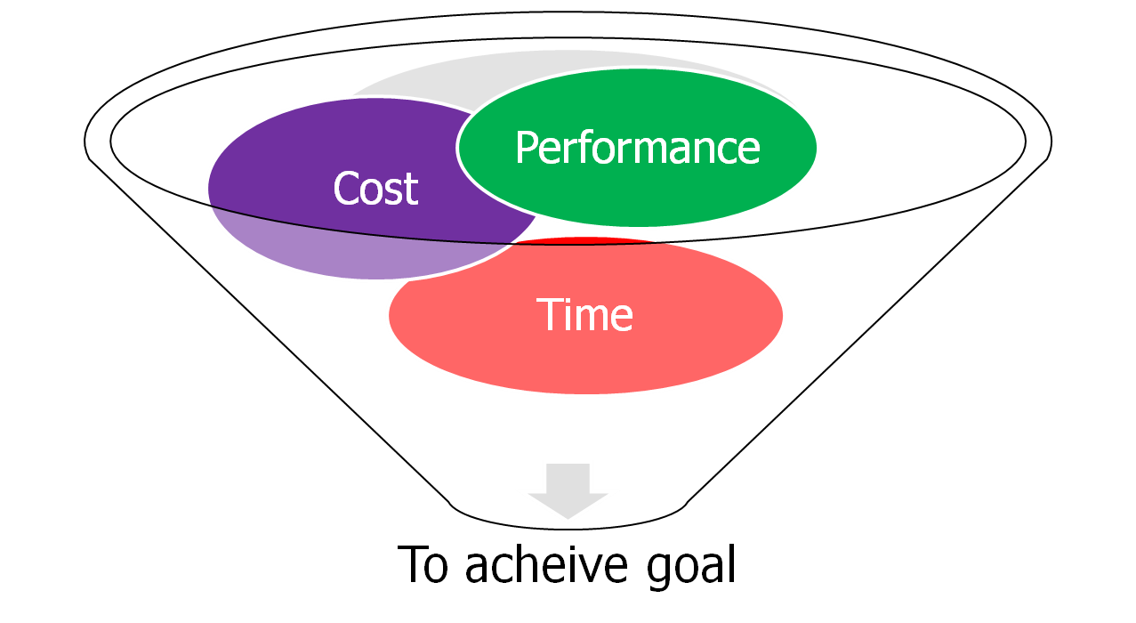
Project Targets

Slide 5
Characteristics of Project
One time activity with quantifiable end results
Existance of life cycle in project duration
Set of Constraints
Interdependance
Uniqueness

Slide 6
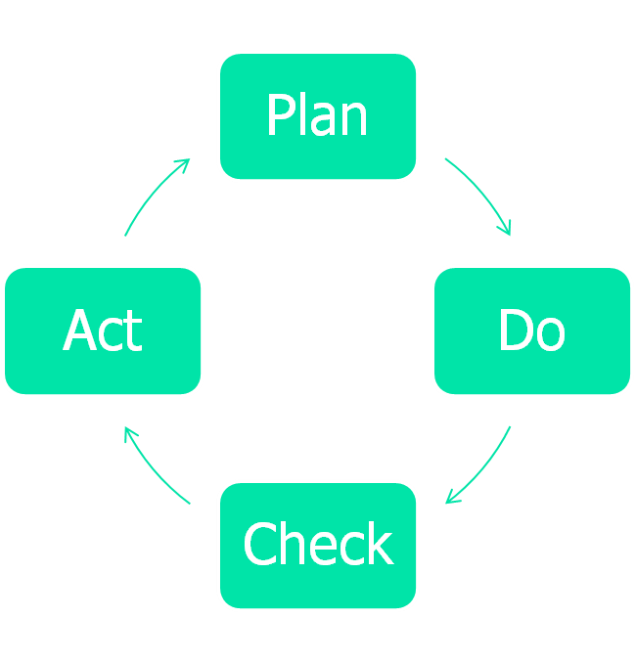
Approach to Constant Improvement
Three Phases of PM
Design it
Do it
Develop it

Slide 7
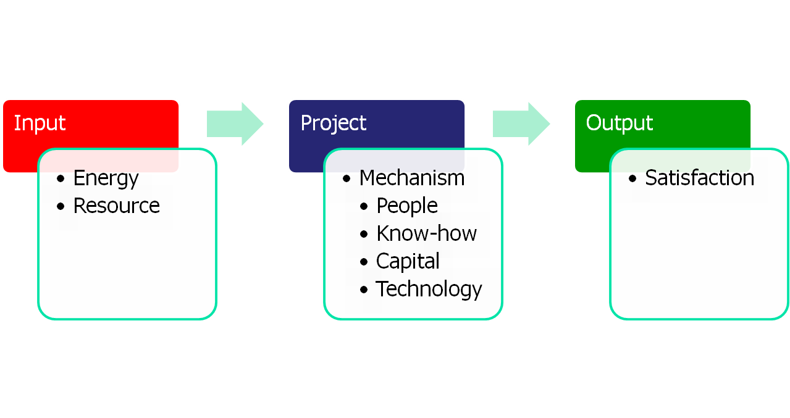
Project as a Conversion Process
Constraints
Financial, Legal, Ethical, Environmental and so on

Slide 8
What is Project Management?
Project + Management
Specific Goal
Specific Resources
Specific Time Frame
Planning, Organizing
Staffing, Leading,
Controlling towards
goal attainment

Slide 9
Development of Project Management
Expansion of knowledge and more segregation in academic discipline
Complex demand for goods and services
Globalization
Cultural
Environmental

Slide 10
Stages of Project Management
Define
Plan
Implement
Monitor
Adjust
Evaluate
Celebrate ☺

Slide 11
Project Management Coverage
Earth/Universe Level
Project Management
is the tool to achieve
Goals at any level-
By initiating task, action
and activity
Regional/Inter-continental Level
National Level
Company Level

Slide 12
Work breakdown structure
A method of breaking down a project into individual elements ( components, subcomponents, activities and tasks) in a hierarchical structure which can be scheduled
It defines tasks that can be completed independently of other tasks, facilitating resource allocation, assignment of responsibilities and measurement and control of the project
It is foundation of project planning
It is developed before identification of dependencies and estimation of activity durations
It can be used to identify the tasks in the CPM and PERT

Slide 13
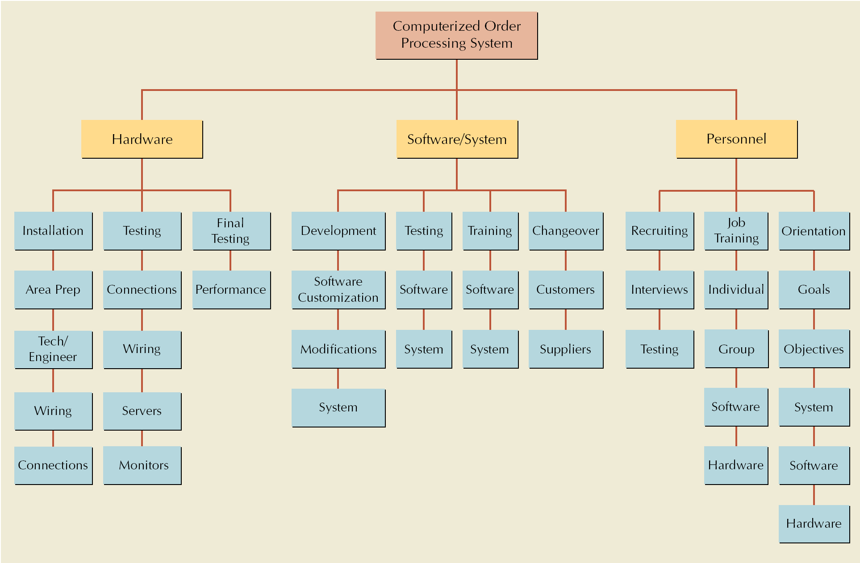
Work Breakdown Structure for Computer Order Processing System Project

Slide 14
Project Scheduling and Control Techniques
Gantt Chart
Critical Path Method (CPM)
Program Evaluation and Review Technique (PERT)

Slide 15
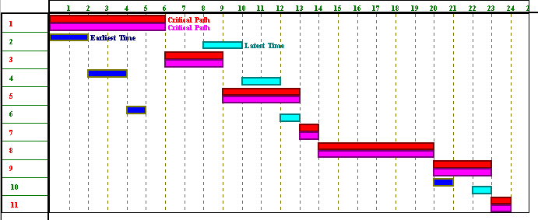
Gantt Chart
Graph or bar chart with a bar for each project activity that shows passage of time
Provides visual display of project schedule

Slide 16
Gantt chart
Advantages
- Gantt charts are quite commonly used. They provide an easy graphical representation of when activities (might) take place.
Limitations
Do not clearly indicate details regarding the progress of activities
Do not give a clear indication of interrelation ship between the separate activities

Slide 17
CPM - Critical Path Method
Definition: In CPM activities are shown as a network of precedence relationships using activity-on-node network construction
Single estimate of activity time
Deterministic activity times
USED IN : Production management - for the jobs of repetitive in nature where the activity time estimates can be predicted with considerable certainty due to the existence of past experience.

Slide 18
PERT - Project Evaluation & Review Techniques
Definition: In PERT activities are shown as a network of precedence relationships using activity-on-arrow network construction
Multiple time estimates
Probabilistic activity times
USED IN : Project management - for non-repetitive jobs (research and development work), where the time and cost estimates tend to be quite uncertain. This technique uses probabilistic time estimates.

Slide 19
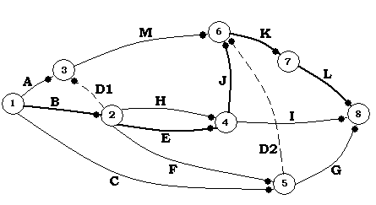
CPM/PERT
Deficiencies (in Gantt Chart) can be eliminated to a large extent by showing the interdependence of various activities by means of connecting arrows called network technique.
Overtime CPM and PERT became one technique
ADVANTAGES:
Precedence relationships
large projects
more efficient

Slide 20
Project Network
Network analysis is the general name given to certain specific techniques which can be used for the planning, management and control of projects
Use of nodes and arrows
Arrows ➔ An arrow leads from tail to head directionally
Indicate ACTIVITY, a time consuming effort that is required to perform a part of the work.
Nodes  A node is represented by a circle
- Indicate EVENT, a point in time where one or more activities start and/or finish.
Activity
A task or a certain amount of work required in the project
Requires time to complete
Represented by an arrow
Dummy Activity
Indicates only precedence relationships
Does not require any time of effort

Slide 21
Project Network
Event
Signals the beginning or ending of an activity
Designates a point in time
Represented by a circle (node)
Network
Shows the sequential relationships among activities using nodes and arrows
Activity-on-node (AON)
nodes represent activities, and arrows show precedence relationships
Activity-on-arrow (AOA)
arrows represent activities and nodes are events for points in time

Slide 22
AOA Project Network for House
3
Lay foundation
Dummy
2
0
Build house
Finish work
1
3
2
1
4
6
7
Design house and obtain financing
Order and receive materials
3
1
1
1
Select paint
Select carpet
5
AON Project Network for House
Lay foundations
Build house
2
4
2
3
Finish work
7
Start
1
1
3
Design house and obtain financing
3
6
1
5
1
1
Select carpet
Order and receive materials
Select paint

Slide 23
Situations in network diagram
B
A
A must finish before either B or C can start
C
A
C
both A and B must finish before C can start
B
A
C
both A and C must finish before either of B or D can start
B
D
A
B
A must finish before B can start
both A and C must finish before D can start
Dummy
C
D

Slide 24
CPM calculation
Path
A connected sequence of activities leading from the starting event to the ending event
Critical Path
The longest path (time); determines the project duration
Critical Activities
All of the activities that make up the critical path

Slide 25
Forward Pass
Earliest Start Time (ES)
earliest time an activity can start
ES = maximum EF of immediate predecessors
Earliest finish time (EF)
earliest time an activity can finish
earliest start time plus activity time
EF= ES + t
Backward Pass
Latest Start Time (LS)
Latest time an activity can start without delaying critical path time
LS= LF - t
Latest finish time (LF)
latest time an activity can be completed without delaying critical path time
LS = minimum LS of immediate predecessors

Slide 26
CPM analysis
Draw the CPM network
Analyze the paths through the network
Determine the float for each activity
Compute the activity’s float
float = LS - ES = LF - EF
Float is the maximum amount of time that this activity can be delay in its completion before it becomes a critical activity, i.e., delays completion of the project
Find the critical path is that the sequence of activities and events where there is no “slack” i.e.. Zero slack
Longest path through a network
Find the project duration is minimum project completion time

Slide 27
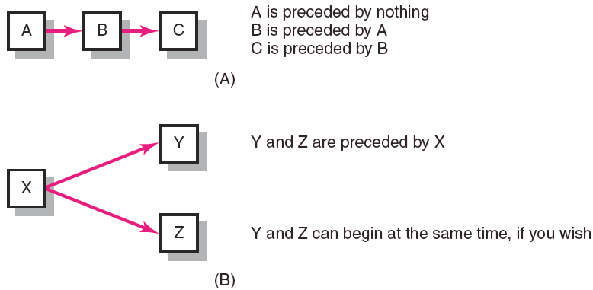
Activity-on-Node Fundamentals
FIGURE 6.2

Slide 28
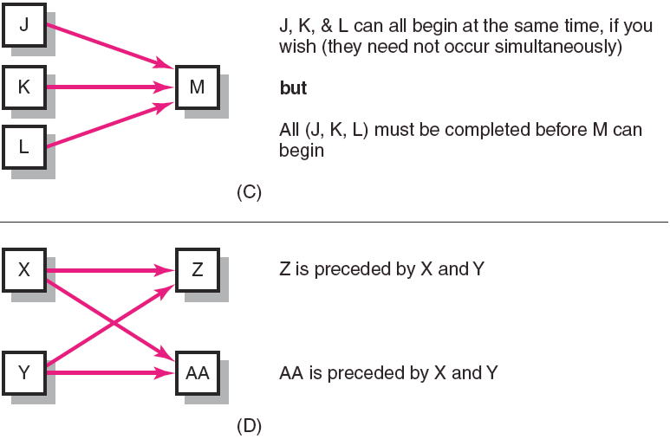
Activity-on-Node Fundamentals (cont’d)
FIGURE 6.2 (cont’d)

Slide 29
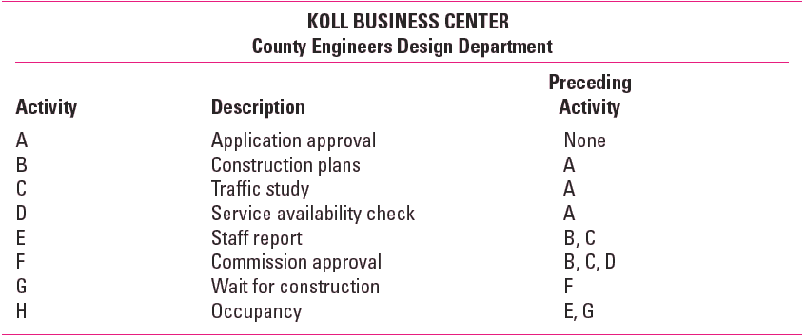
Network Information
TABLE 6.1

Slide 30
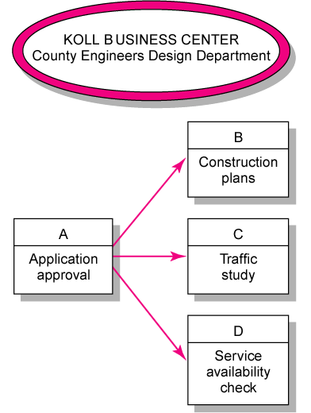
Koll Business Center—Partial Network
FIGURE 6.3

Slide 31
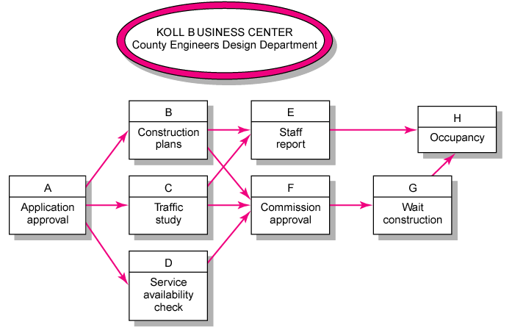
Koll Business Center—Complete Network
FIGURE 6.4

Slide 32
Network Computation Process
Forward Pass—Earliest Times
How soon can the activity start? (early start—ES)
How soon can the activity finish? (early finish—EF)
How soon can the project finish? (expected time—ET)
Backward Pass—Latest Times
How late can the activity start? (late start—LS)
How late can the activity finish? (late finish—LF)
Which activities represent the critical path?
How long can it be delayed? (slack or float—SL)

Slide 33
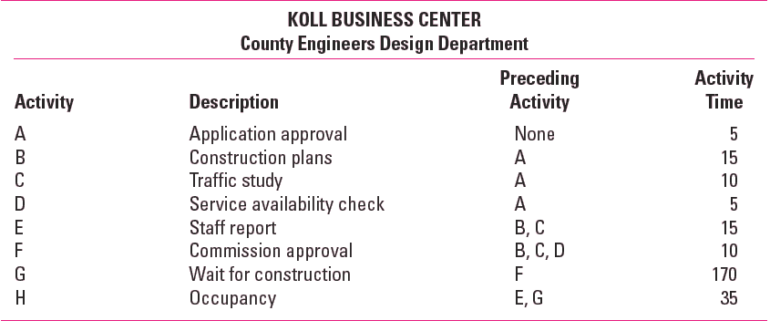
Network Information
TABLE 6.2

Slide 34
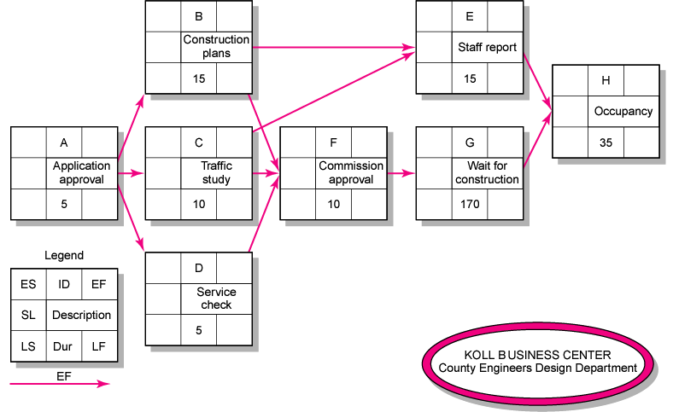
Activity-on-Node Network
FIGURE 6.5

Slide 35
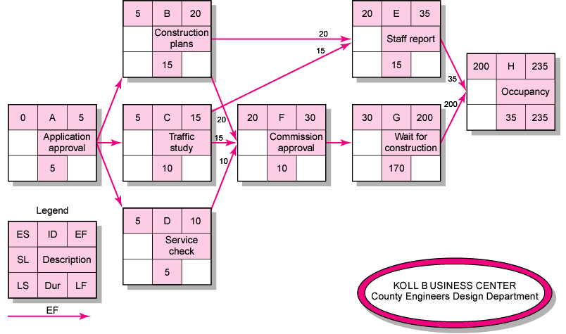
Activity-on-Node Network Forward Pass
FIGURE 6.6

Slide 36
Forward Pass Computation
Add activity times along each path in the network (ES + Duration = EF).
Carry the early finish (EF) to the next activity where it becomes its early start (ES) unless…
The next succeeding activity is a merge activity, in which case the largest EF of all preceding activities is selected.

Slide 37
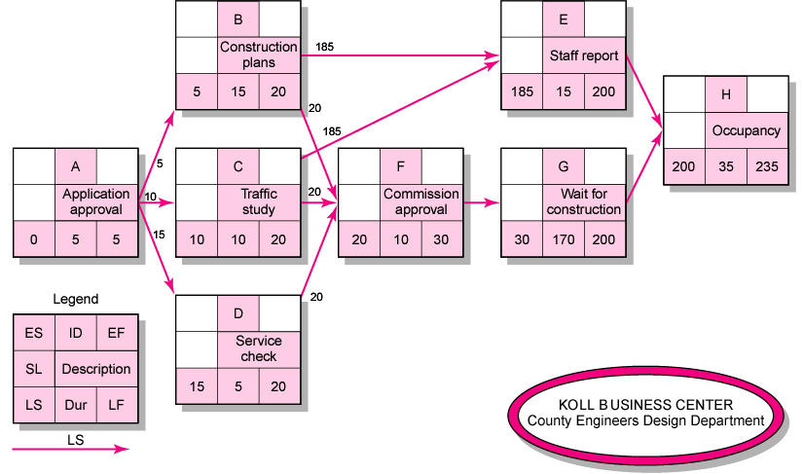
Activity-on-Node Network Backward Pass
FIGURE 6.7

Slide 38
Backward Pass Computation
Subtract activity times along each path in the network (LF - Duration = LS).
Carry the late start (LS) to the next activity where it becomes its late finish (LF) unless...
The next succeeding activity is a burst activity, in which case the smallest LF of all preceding activities is selected.

Slide 39
Determining Slack (or Float)
Free Slack (or Float)
The amount of time an activity can be delayed without delaying connected successor activities
Total Slack
The amount of time an activity can be delayed without delaying the entire project
The critical path is the network path(s) that has (have) the least slack in common.

Slide 40
Sensitivity of a Network
The likelihood the original critical path(s) will change once the project is initiated.
Function of:
The number of critical paths
The amount of slack across near critical activities

Slide 41
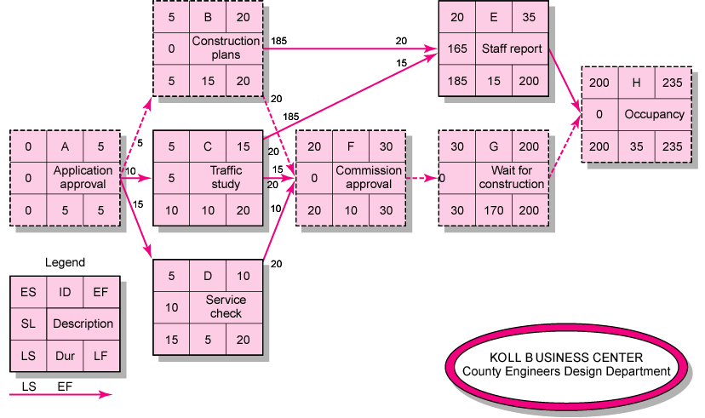
Activity-on-Node Network with Slack
FIGURE 6.8

Slide 42
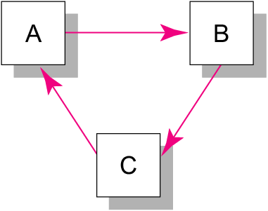
Illogical Loop
FIGURE 6.9

Slide 43
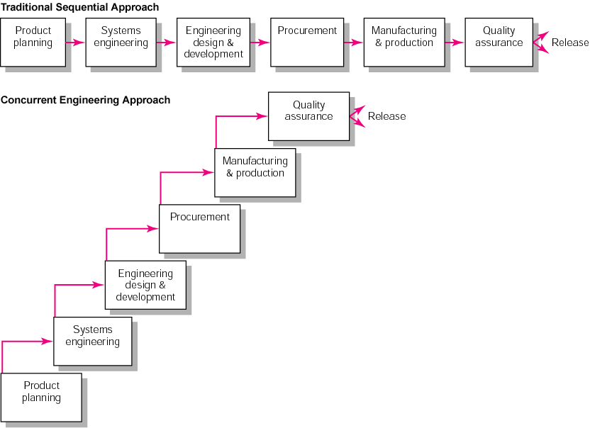
New Product Development Process
FIGURE 6.16

Slide 44
Key Terms
Activity
Activity-on-arrow (AOA)
Activity-on-node (AON)
Concurrent engineering
Critical path
Early and late times
Gantt chart
Merge activity
Network sensitivity
Parallel activity
Slack/float

Slide 45
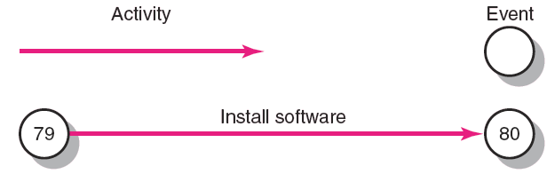
Activity-on-Arrow Network Building Blocks
FIGURE A6.1

Slide 46
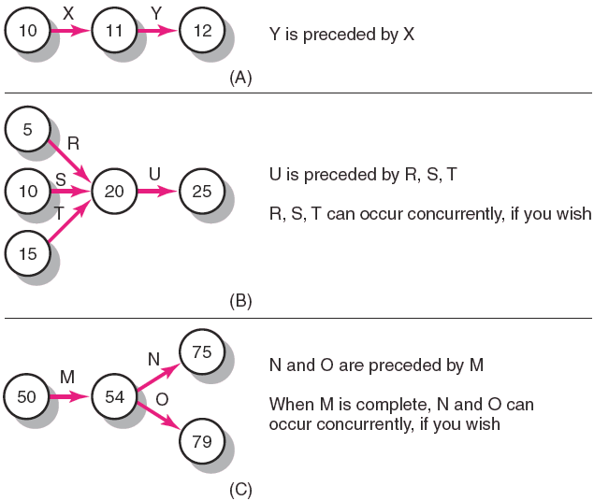
Activity-on-Arrow Network Fundamentals
FIGURE A6.2

Slide 47
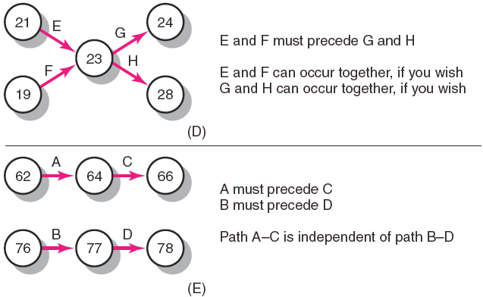
Activity-on-Arrow Network Fundamentals
FIGURE A6.2 (cont’d)

Slide 48
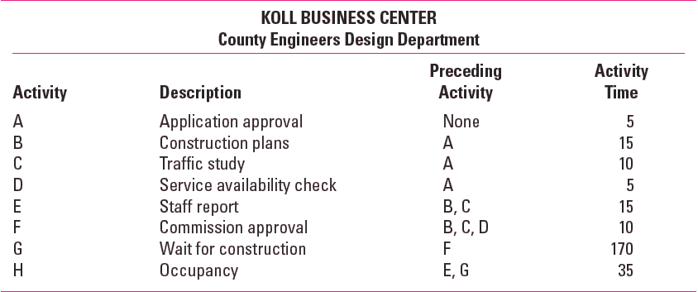
Koll Center Project: Network Information
TABLE A6.3

Slide 49
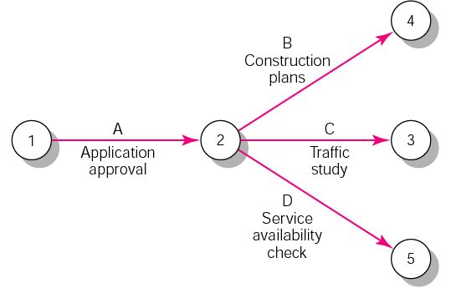
Partial Koll Business Center AOA Network
FIGURE A6.3

Slide 50
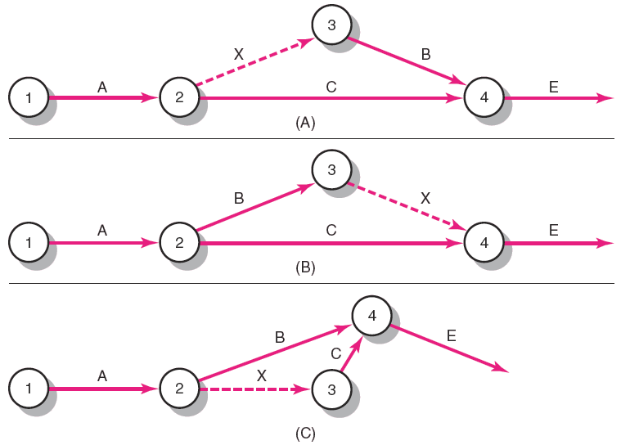
Partial AOA Koll Network
FIGURE A6.4

Slide 51
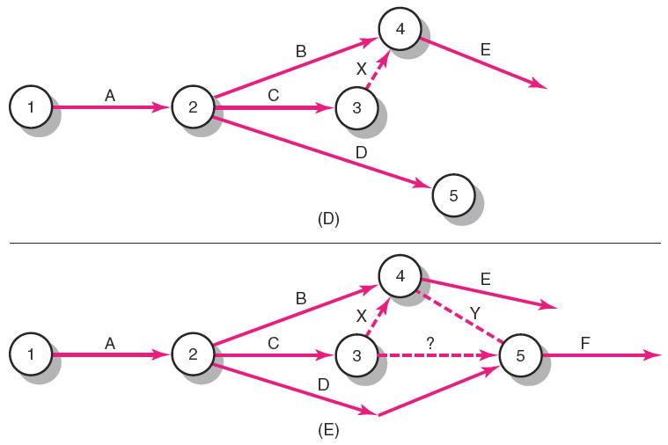
Partial AOA Koll Network (cont’d)
FIGURE A6.4 (cont’d)

Slide 52
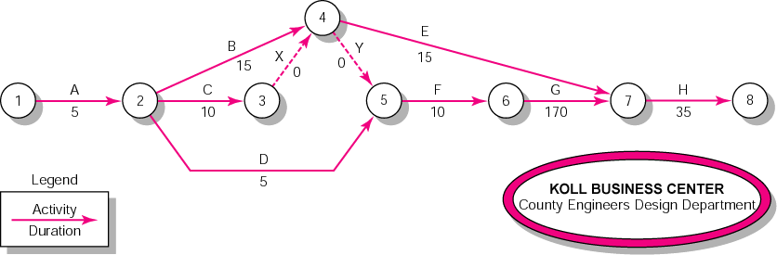
Activity-on-Arrow Network
FIGURE A6.5

Slide 53
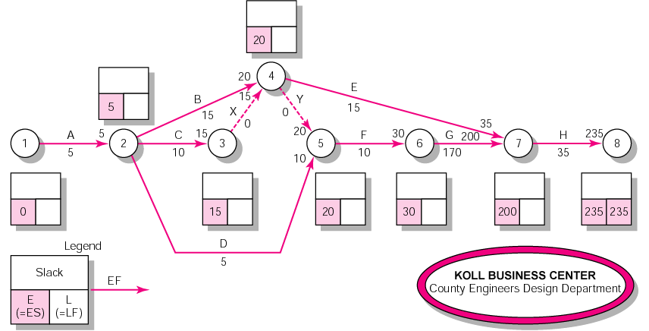
Activity-on-Arrow Network Forward Pass
FIGURE A6.6

Slide 54
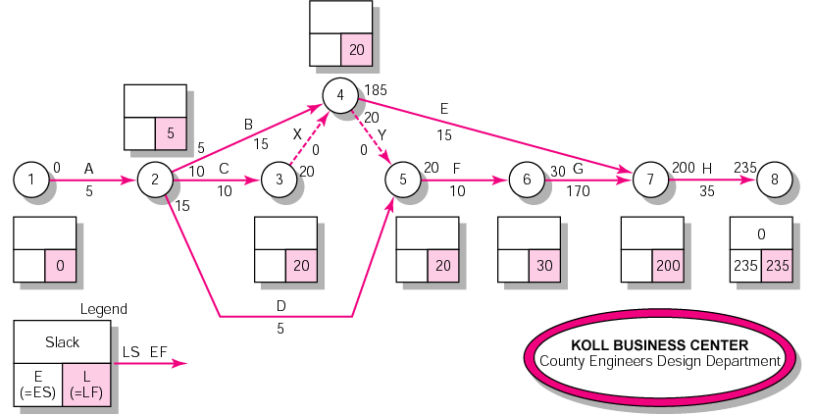
Activity-on-Arrow Network Backward Pass
FIGURE A6.7

Slide 55
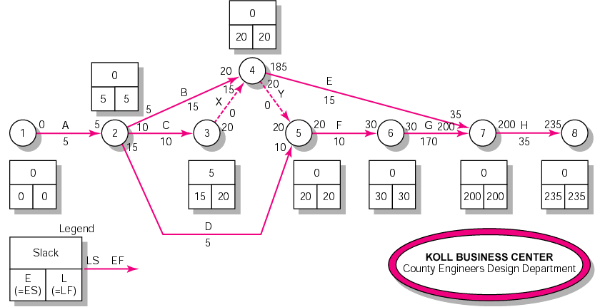
Activity-on-Arrow Network Backward Pass, Forward Pass, and Slack
FIGURE A6.8

Slide 56
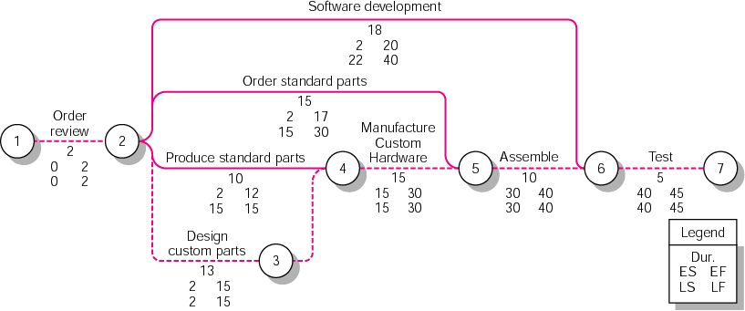
Air Control Inc. Custom Order Project—AOA Network Diagram
FIGURE A6.9

Slide 57
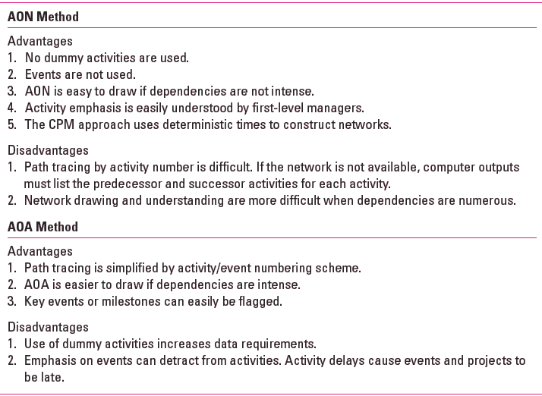
Comparison of AON and AOA Methods
TABLE A6.2

Slide 58
PERT
PERT is based on the assumption that an activity’s duration follows a probability distribution instead of being a single value
Three time estimates are required to compute the parameters of an activity’s duration distribution:
pessimistic time (t_{p} ) - the time the activity would take if things did not go well
most likely time (t_{m} ) - the consensus best estimate of the activity’s duration
optimistic time (t_{o} ) - the time the activity would take if things did go well
t_{p} + 4 t_{m} + t_{o}
6
Mean (expected time): t_{e} =
2
t_{p} - t_{o}
6
Variance: V_{t} =σ ² =

Slide 59
PERT analysis
Draw the network.
Analyze the paths through the network and find the critical path.
The length of the critical path is the mean of the project duration probability distribution which is assumed to be normal
The standard deviation of the project duration probability distribution is computed by adding the variances of the critical activities (all of the activities that make up the critical path) and taking the square root of that sum
Probability computations can now be made using the normal distribution table.

Slide 60
Probability computation
Determine probability that project is completed within specified time
x - μ
Z =
σ
where μ = t_{p} = project mean time
σ = project standard mean time
x = (proposed ) specified time

Slide 61
PERT Example
Immed. Optimistic Most Likely Pessimistic
Activity Predec. Time (Hr.) Time (Hr.) Time (Hr.)
A -- 4 6 8
B -- 1 4.5 5
C A 3 3 3
D A 4 5 6
E A 0.5 1 1.5
F B,C 3 4 5
G B,C 1 1.5 5
H E,F 5 6 7
I E,F 2 5 8
J D,H 2.5 2.75 4.5
K G,I 3 5 7

Slide 62
PERT Example
PERT Network
D
A
E
H
J
C
B
I
K
F
G

Slide 63
PERT Example
Activity Expected Time Variance
A 6 4/9
B 4 4/9
C 3 0
D 5 1/9
E 1 1/36
F 4 1/9
G 2 4/9
H 6 1/9
I 5 1
J 3 1/9
K 5 4/9

Slide 64
PERT Example
Activity ES EF LS LF Slack
A 0 6 0 6 0 *critical
B 0 4 5 9 5
C 6 9 6 9 0 *
D 6 11 15 20 9
E 6 7 12 13 6
F 9 13 9 13 0 *
G 9 11 16 18 7
H 13 19 14 20 1
I 13 18 13 18 0 *
J 19 22 20 23 1
K 18 23 18 23 0 *

Slide 65
PERT Example
V_{path} = V_{A} + V_{C} + V_{F} + V_{I} + V_{K}
= 4/9 + 0 + 1/9 + 1 + 4/9
= 2
σ_{path} = 1.414
z = (24 - 23)/σ = (24-23)/1.414 = .71
From the Standard Normal Distribution table:
P(z < .71) = .5 + .2612 = .7612

Slide 66
Project Crashing
Crashing
reducing project time by expending additional resources
Crash time
an amount of time an activity is reduced
Crash cost
cost of reducing activity time
Goal
reduce project duration at minimum cost

Slide 67
Activity crashing
Crash cost
Crashing activity
Slope = crash cost per unit time
Activity cost
Normal Activity
Normal cost
Normal time
Crash time
Activity time

Slide 68
Benefits of CPM/PERT
Useful at many stages of project management
Mathematically simple
Give critical path and slack time
Provide project documentation
Useful in monitoring costs
CPM/PERT can answer the following important questions:
How long will the entire project take to be completed? What are the risks involved?
Which are the critical activities or tasks in the project which could delay the entire project if they were not completed on time?
Is the project on schedule, behind schedule or ahead of schedule?
If the project has to be finished earlier than planned, what is the best way to do this at the least cost?

Slide 69
Limitations to CPM/PERT
Clearly defined, independent and stable activities
Specified precedence relationships
Over emphasis on critical paths
Deterministic CPM model
Activity time estimates are subjective and depend on judgment
PERT assumes a beta distribution for these time estimates, but the actual distribution may be different
PERT consistently underestimates the expected project completion time due to alternate paths becoming critical
To overcome the limitation, Monte Carlo simulations can be performed on the network to eliminate the optimistic bias

Slide 70
Practice Example
A social project manager is faced with a project with the following activities:
Activity Description | Duration
Social work team to live in village | 5w
Social research team to do survey | 12w
Analyse results of survey | 5w
Establish mother & child health program | 14w
Establish rural credit programme | 15w
Carry out immunization of under fives | 4w
Draw network diagram and show the critical path. Calculate project duration.

Slide 71
Practice problem
Activity | Description | Duration
1-2 | Social work team to live in village | 5w
1-3 | Social research team to do survey | 12w
3-4 | Analyse results of survey | 5w
2-4 | Establish mother & child health program | 14w
3-5 | Establish rural credit programme | 15w
4-5 | Carry out immunization of under fives | 4w
4
2
1
5
3

